Slide 1
Economics Case study on the product ‘Kayam Churna’, changes in supply/demand/prices over a time period
Made by: Group 10
Yash Patel (131063)
Atman Dholakia (1401013)
Neel Puniwala (1401024)
Chintan Saraviya (1401026)
Raj Derasari (1401029)
Parth Satodiya (1401056)
Ravi Patel (1401058)
Charvik Patel (1401079)
Assisted By: Prof. Rita Sharma

Slide 2
Introduction
We have tried to analyse changes in demand/supply with price for the product ‘Kayam Churna’, and see how it performed after the introduction of ‘Nityam Churna’ by ‘Zandu’ brand.
Study the trend in price change, profit earned, quantity supplied and demanded, changes in the quality of product, over a time period of ~10 years
Economics concepts applied:
Demand Theory
Supply Theory
Price Elasticity of demand
Cross Elasticity of demand

Slide 3
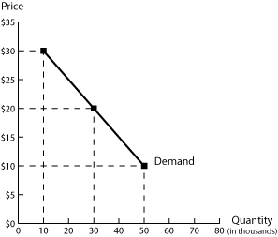
Demand Theory
Law of demand: Keeping other factors constant, the quantity demanded for a product is inversely proportional to the change in the price of the product.
Hence when the price of the product increases there should be a decrease in the quantity demand of the product
It can be represented by the graph

Slide 4
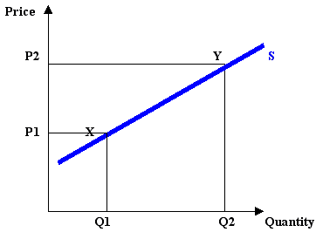
Supply Theory
Law of supply: Keeping other factors constant, the quantity supplied for a product is directly proportional to the change in the price of the product.
Hence when the price of the product increases there should be a increase in the net quantity supply of the product
It can be represented by the graph

Slide 5
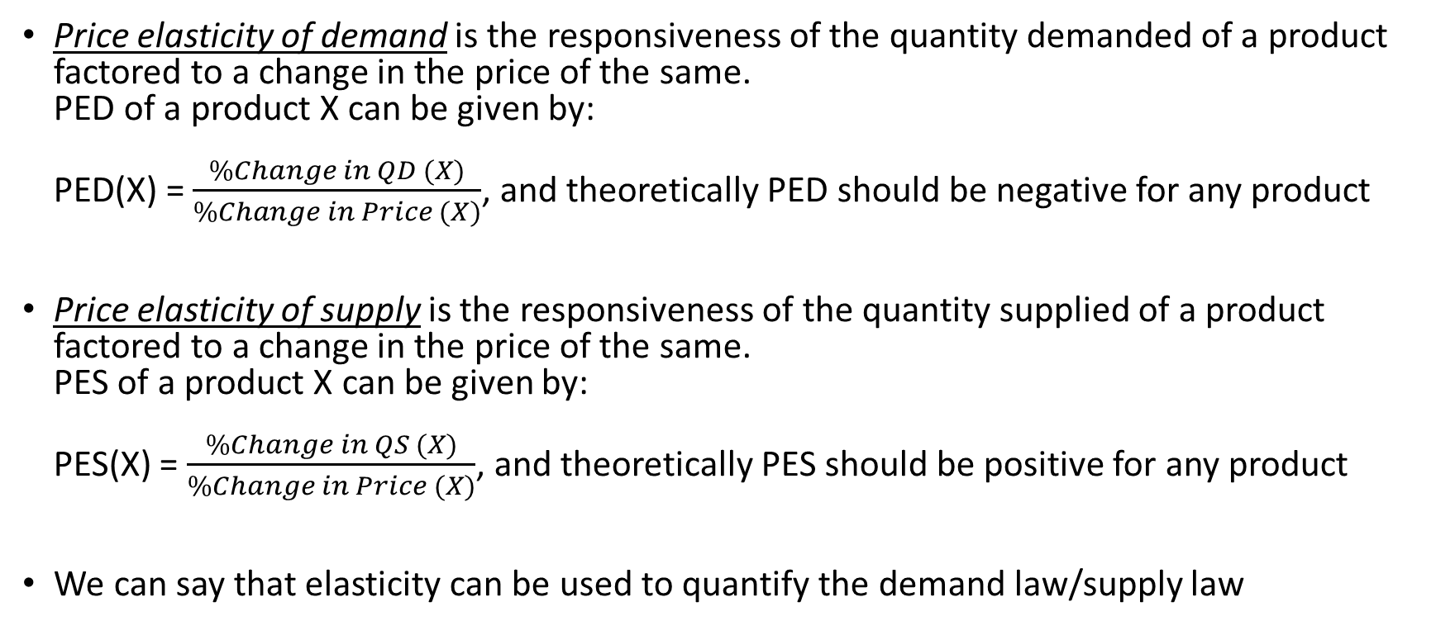
Price elasticity definitions
Price elasticity of demandis the responsiveness of the quantity demanded of a product factored to a change in the price of the same. PED of a product X can be given by: PED(X) = $\frac{\%Change in QD (X)}{\%Change in Price (X)}$, and theoretically PED should be negative for any product
Price elasticity of supplyis the responsiveness of the quantity supplied of a product factored to a change in the price of the same. PES of a product X can be given by: PES(X) = $\frac{\%Change in QS (X)}{\%Change in Price (X)}$, and theoretically PES should be positive for any product
We can say that elasticity can be used to quantify the demand law/supply law

Slide 6
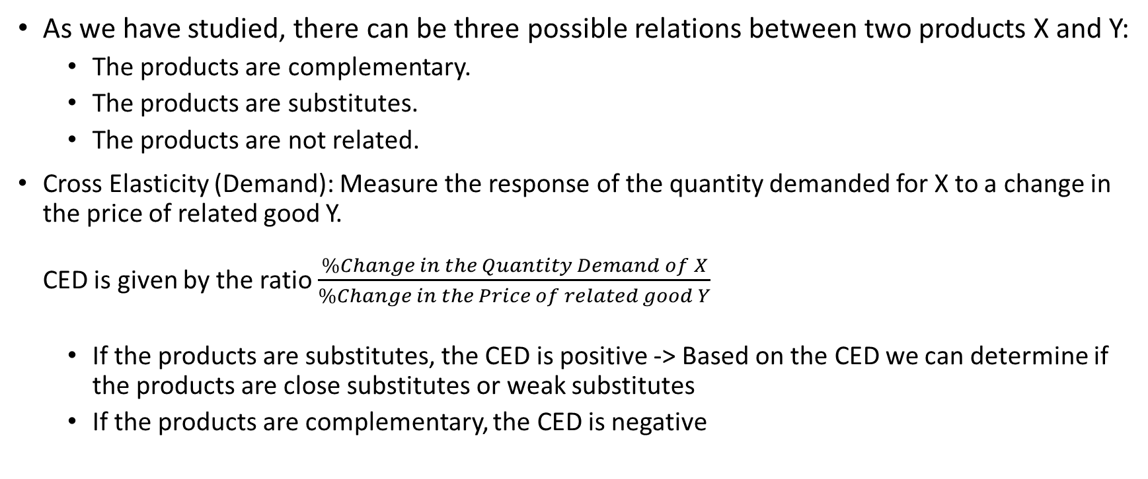
Cross elasticity
As we have studied, there can be three possible relations between two products X and Y:
The products are complementary.
The products are substitutes.
The products are not related.
Cross Elasticity (Demand): Measure the response of the quantity demanded for X to a change in the price of related good Y. CED is given by the ratio $\frac{\%Change in the Quantity Demand of X}{\%Change in the Price of related good Y}$
If the products are substitutes, the CED is positive -> Based on the CED we can determine if the products are close substitutes or weak substitutes
If the products are complementary, the CED is negative

Slide 7
Factors affecting demand and supply
Well, there isn’t a large variety of factors affecting the demand of ‘churna’. The main factors that affect the demand for this product are:
Price of the product for the given amount/weight
Population, awareness of the existence of the product
Brand value / (what the population thinks of the brand)
Quality of the product provided / (product reputation)
Existence of substitutes / (competing brands)
Factors affecting supply of the product:
Production cost
Demand
Profit margin (based on production cost and demand)

Slide 8
Observations and Notes
‘Kayam Churna’
Introduced in 2005, price 50/- for 120gms box, 20% profit margin
Between 2005 and 2010 price increases upto ~60/- per box
Substitute products are introduced, and competition increases
As inflation rates increase (around 2009), the weight per box is brought down to 100gms for the same price to decrease the production cost, maintaining a reasonable profit rate “to stay alive”
Gradually, its market is stabilized by more advertising and promotion of the product, and at the latest (2015) a 100gms box costs Rs. 65/-, up from the cost of Rs.60/- per box in 2013.

Slide 9
Graph from Observations and Notes
‘Kayam Churna‘
We observe that as the average price increased over a period of 10 years, the demand actually increases instead of decreasing:
In 2010 average price was Rs. 60/- but due to increasing popularity of ‘Kayam Churna’ in the market the demand increases, contrary to theoretical expectation
In 2011 new products introduced, demand decreases even though price decreases (to Rs. 45/-)
Post 2011, sales recover by more advertisement and promotion, gradually prices increase (to Rs. 65/-) but the demand also increases. (positive price elasticity is observed for most of the price changes)

Slide 10
Observations and Notes
Zandu Nitya Churna
Introduced later, in 2011, at an introductory price tag of Rs. 40/- for 100gms box, at 15% profit margin. It was in direct competition against Kayam Churna
Prices steadily increase with time, but due to average income increase in the population and such, sales do not decline, but rather, grow marginally, due to the increasing popularity of the product with good brand value.
The product has been mostly stable, there have been no major upsets in the trends since its introduction. At the end of 2015 it costs Rs. 54 for 100gms.

Slide 11
Graph from Observations and Notes
‘Nityam Churna‘
This graph presents the representative data for sales of ‘Nityam Churna’ over 2010 to 2015.
So far it has an almost stable price, with no change in quality/quantity of the product, and demand has been gradually increasing lead by the promotion and advertisement of the product, and because of high brand value for ‘Zandu’

Slide 12
Observations and Notes
Relatively new brands of ‘churna’:
Patanjali brand has recently released a range of ‘churna’, all within the range of Rs.35 to Rs.50 per box (all 100gms), as time passes we may be able to tell how this impacts the products of the other two brands.
Kranti pharmaceuticals, (inception in 2008) have recently released their brand of ‘churna’, expected to be @Rs.40 per 100gms box, and upto Rs.150 per 400gms. The brand is relatively unknown but as the popularity increases, there should be a positive change in quantity demand

Slide 13
Observed Trends: Kayam/Nityam Churna
Notes:
Zandu trends begin from 2011
Kayam prices decrease in 2009-2010, following recession, to maintain profit margin they reduce weight per box from 120gms to 100gms
After stabilising the quantity demand and price gradually increase
Price values are in Rs.,and Quantity demanded are in units/month

Slide 14
Observed Trends: Kayam/Nityam Churna
Notes:
Zandu trends begin from 2011
Kayam prices decrease in 2009-2010, following recession, to maintain profit margin they reduce weight per box from 120gms to 100gms
After stabilising the quantity demand and price gradually increase
Price values are in Rs.,and Quantity demanded are in units/month

Slide 15
Elasticity of the product under given conditions
Kayam Churna
Nityam Churna
Price/Yr | Qd/Yr
Rs.44(2011) | 80
Rs.50(2012) | 90
Rs.50(2013) | 105
Rs.60(2014) | 115
Rs.65(2015) | 125
Price/Yr | Qd/Yr
Rs.50(2011) | 50
Rs.45(2012) | 60
Rs.50(2013) | 70
Rs.50(2014) | 85
Rs.54(2015) | 100

Slide 16
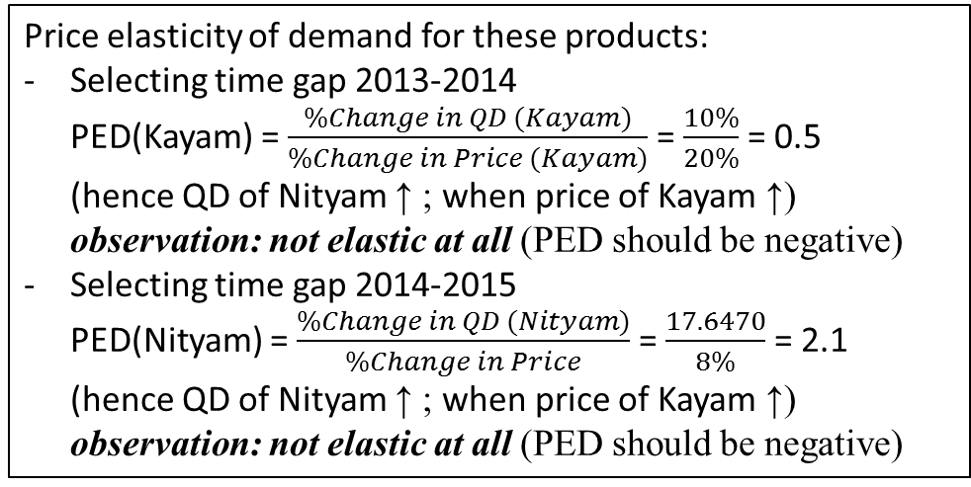
Price elasticity

Slide 17
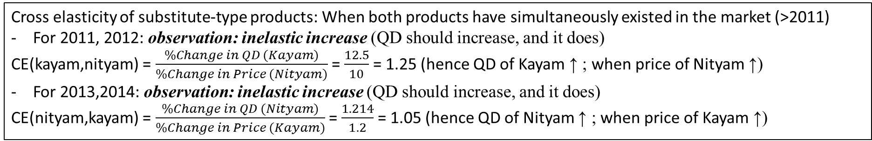
Cross elasticity

Slide 18
References, sources
“Dholakia brothers” pharmacy for representative data in sales figures and cost prices of both products since 2005 to 2015, courtesy of Atman Dholakia
“Managerial Economics”, textbook for various definitions on economics concepts
http://kdkchadha.blogspot.in/2009/11/theory-of-supply-level-economics.html
http://www.econport.org/content/handbook/Demand/Graph.html

Slide 19
THANK YOU

